Slide 1
PRESENTATION TITLE

Slide 2
Learning objectives
Learning objectives for this presentation:
Paste the objectives here.
Make sure they all have full stops.
Make sure they all start with an imperative verb.
The box is H: 1cm and V: 4cm.

Slide 3
Types of data
All text should be in Roboto, size 24.
Main text should be dark grey #444444.
The first text box on every page should be aligned at H: 1cm and V: 2cm.
All other text should be aligned at H: 1cm.
Key info can be in pale blue filled boxes. #C1E0EF
Reminders go in purple boxes, 3pt line. #C393E0
Instructions are in green boxes. If it’s a question, it is emboldened. #C1E363
Answers to questions are in orange edged boxes, 3pt line. #FF9F25

Slide 4
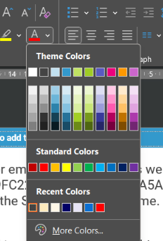
For emphasis on words, as well as bold, use this green #9FC225, use this blue #5A5AC1. All colours are listed in the Statistics colour theme.
All items on the slide should use the ‘fade’ OR ‘appear’ animation – whichever you choose to use make sure it is consistently used within the subject – don’t mix the two. There should be something on the slide when the slide appears.
Subsequent items should appear on click in sensible chunks, and each item or chunk should convey a significant amount of info (i.e. not just an image).

Slide 5
Sort the types of data
Please use this style for speech bubbles.
Arrow style:
Heading 1 | Heading 2 | Heading 3
Text | Text | Text
Text | Text | Text
Text | Text | Text
Text | Text | Text
Use format painter to apply this style to existing speech bubbles from older ppts.

Slide 6
End

